Slide 1
Eigenvalues &
Eigenvectors
Course : MATH6183 – Scientific Computing
Year : 2021

Slide 2
Outlines
Initial Value Problems
Numerical Error and Instability
Euler Method
Runge-Kutta Methods

Slide 3

Introduction
We learned from the previous chapter that matrix A applied to a column vector x, that is, Ax, is a linear transformation of x. There is a special transform in the following form:
where A is an n×n matrix, x is an n×1 column vector (x ≠ 0), and λ is a scalar. Any scalar λ that satisfies the above equation is known as an eigenvalue of the matrix A, while the associated vector x is called an eigenvector corresponding to λ.
The motivation is that if we understand the characteristics of the linear transformation, it will help us to essentially transforms the vector (or matrix) A into another vector (or matrix) that we need, by scaling (stretching, compressing, or flipping) and rotating our initial matrix!

Slide 4


Introduction
The standard form of the matrix eigenvalue problem is
where A is a given n ×n matrix. The problem is to find the scalar λ and the vector x. In order to Ax = λx, we can use the following form:
where I is the identify matrix with the same dimensions as A. If matrix A −λI has an inverse and both sides are multiplied by (A −λI)⁻¹,we get a trivial solution x = 0. Therefore, the only interesting case is when A −λI is singular (no inverse exists), and we have a nontrivial solution, which means that the determinant is zero :
This equation is called the characteristic equation that will lead to a polynomial equation for λ, which we can solve for the eigenvalues;

Slide 5
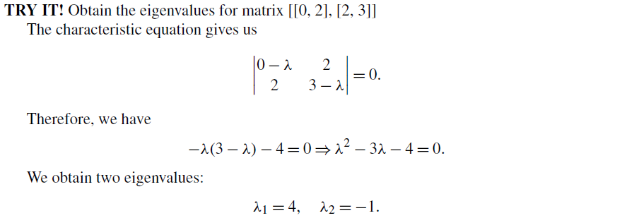
Example 1

Slide 6
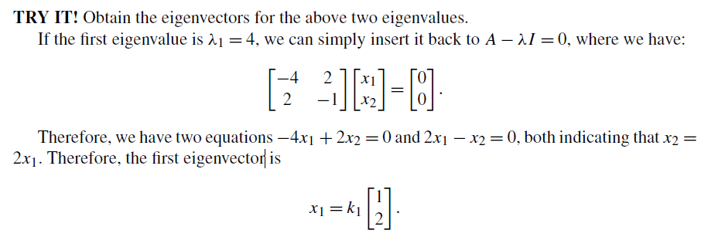
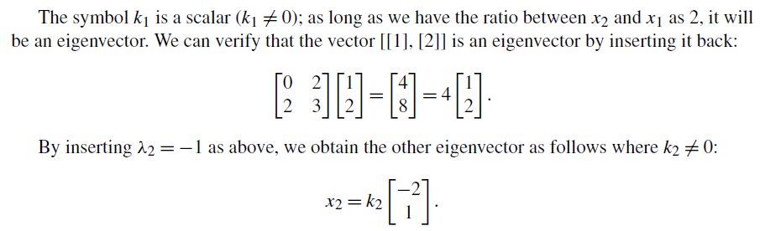
Example 1

Slide 7



Example 2
Consider the matrix
The characteristic equation is
The roots of this equation are λ₁ = 0, λ₂ = 1, λ₃ = 3. To compute the eigenvector corresponding the λ₃, we substitute λ = λ₃ into (A-λI)x = 0 obtaining

Slide 8



Example 2
Choosing x₁ = 1, the first equation of last equation yields x₂ = −2 and from the third equation we get x₃ = 1. Thus, the eigenvector associated with λ₃ is
The other two eigenvectors
can be obtained in the same manner.
It is sometimes convenient to display the eigenvectors as columns of a matrix X. For the problem at hand, this matrix is

Slide 9
Example 2
It is customary to normalize the eigenvectors by assigning a unit magnitude to each vector. Thus the normalized eigenvectors in our example are
When you have a larger matrix A and try to solve the nth order polynomial characteristic equation, the solution becomes more complicated.
We will introduce the Power Method and the QR method in the next two sections.

Slide 10
Power Method
The power method converges to the eigenvalue furthest from zero and the associated eigenvector. It is very similar to the inverse power method; the only difference between the two methods is the interchange of v and z. is an iterative method that will converge to the largest eigenvalue; see the example below.
The outline of the procedure is:
Let v be an approximation to x₁ (a random vector of unit magnitude will do).
Compute the vector z = Av
Compute |z|.
Let v = z/|z| and repeat steps 2–4 until the change in v is negligible.
At the conclusion of the procedure, |z| = ±λ_{n} and v = x_{n} (the sign of λ_{n} is determined in the same way as in the inverse power method).

Slide 11

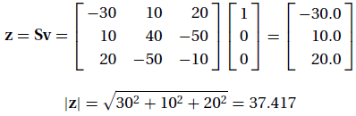
Example
The stress matrix describing the state of stress at a point is
Determine the largest principal stress (the eigenvalue of S furthest from zero) by the power method.
Solution
First iteration:
Let v = [1 0 0]^{T} be the initial guess for the eigenvector. Then

Slide 12

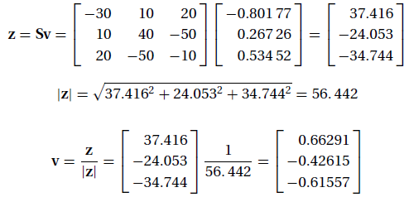
Example
Second iteration:

Slide 13
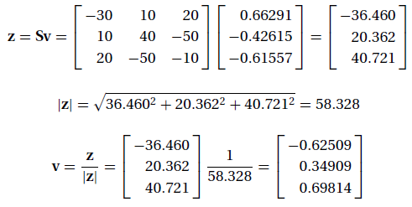
Example
Third iteration:
At this point the approximation of the eigenvalue we seek is λ = −58.328 MPa (the negative sign is determined by the sign reversal of z between iterations). This is actually close to the second-largest eigenvalue λ₂ = −58.39 Mpa. By continuing the iterative process we would eventually end up with the largest eigenvalue λ3 = 70.94 MPa.

Slide 14
Inverse Power Method
The inverse power method is a simple and efficient algorithm that finds the smallest eigenvalue λ₁ and the corresponding eigenvector x₁ of
Ax = λx
The method works like this:
Let v be an approximation to x₁ (a random vector of unit magnitude will do).
Solve Az = v for the vector z.
3. Compute |z|.
Let v = z/|z| and repeat steps 2–4 until the change in v is negligible.
At the conclusion of the procedure, |z| = ±1/λ₁ and v = x₁. The sign of λ₁ is determined as follows: If z changes sign between successive iterations, λ₁ is negative; otherwise, use the plus sign.

Slide 15
Eigenvalue Shifting
The rate of convergence can be improved by a technique called eigenvalue shifting.
Letting
where s is a predetermined “shift,” the eigenvalue problem is transformed to
or
where
Solving the transformed problem by the inverse power method yields λ∗₁ and x₁, where λ∗₁ is the smallest eigenvalue of A∗. The corresponding eigenvalue of the original problem, λ = λ∗₁ + s, is thus the eigenvalue closest to s.

Slide 16
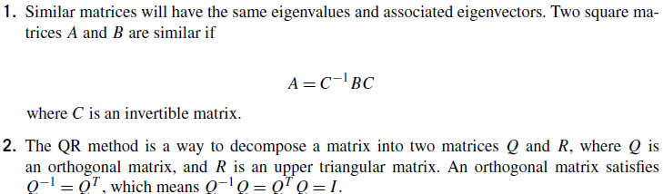
QR Method
The QR method is the preferred iterative method to find all the eigenvalues of a matrix (but not the eigenvectors at the same time). The idea is based on the following two concepts:

Slide 17


QR Method
How do we link these two concepts to find the eigenvalues? Say, we have a matrix A0 whose eigenvalues must be determined. At the kth step (starting with k = 0), we can perform the QR decomposition and obtain
where Qk is an orthogonal matrix, and Rk is an upper triangular matrix. We then form
to obtain

Slide 18
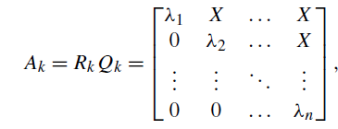
QR Method
Because all the Ak are similar, they all have the same eigenvalues. As the iteration continues, we will eventually converge to an upper triangular matrix with the form:
where the diagonal values are the eigenvalues of the matrix. In each iteration of the QR method, factoring a matrix into an orthogonal and an upper triangular matrix can be done by using a special matrix
called Householder matrix

Slide 19
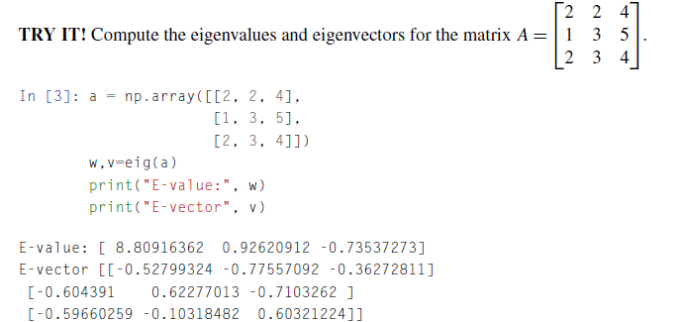
Eigenvalues & Eigenvectors in Python
The methods introduced above are fairly complicated to execute. The calculation of eigenvalues and eigenvectors in Python is fairly easy. The main built-in function in Python to solve the eigenvalue/ eigenvector problem for a square array is the eig function in numpy.linalg;

Slide 20
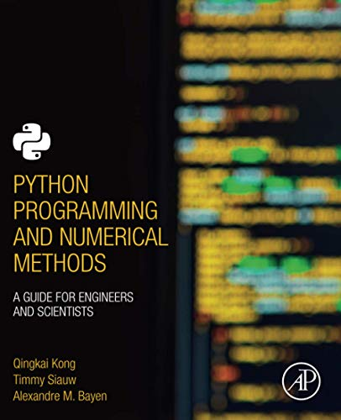
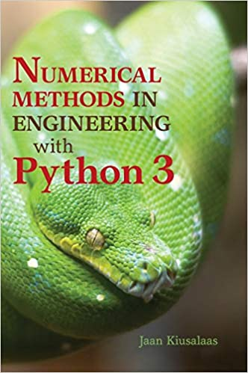
These slides have been adapted from: Kong, Q., Siauw, T., & Bayen, A. M. (2021). Python Programming and Numerical Methods: A Guide for Engineers and Scientists. Academic Press. ISBN: 978-0-12-819549-9 Kiusalaas, J. (2013). Numerical Methods in Engineering with Python 3. United Kingdom: Cambridge University Press. ISBN:9781107033856
Acknowledgement

